Slide 1


Slide 2
About today…
External API Integration
RESTful API

Slide 3

Working with external APIs

Slide 4
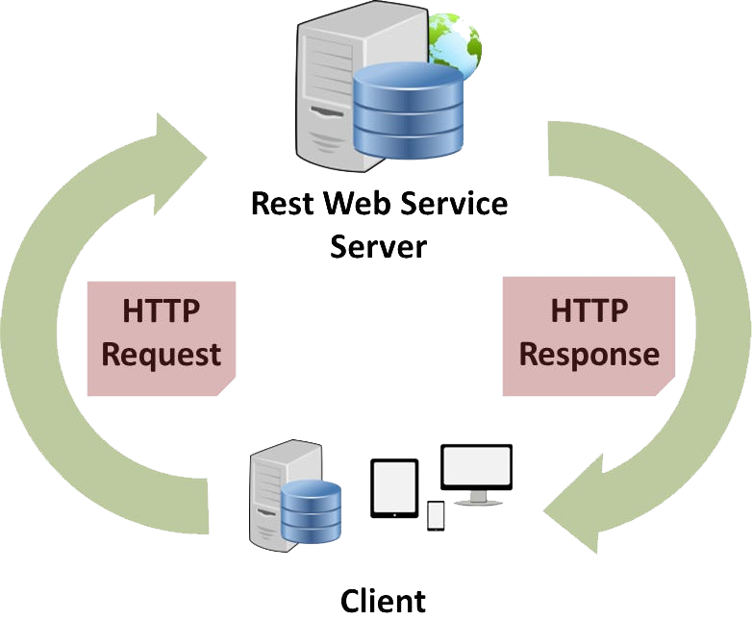
Introduction to RESTful APIs
Definition
REST stands for Representational State Transfer, an architectural style for
designing networked applications
Principle
It relies on stateless, client-server communication, typically over HTTP
Operations
RESTful APIs perform Create, Read, Update, and Delete (CRUD) operations
using standard HTTP methods
Resources
Each piece of data or resource is identified by a URI (Uniform Resource
Identifier)

Slide 5
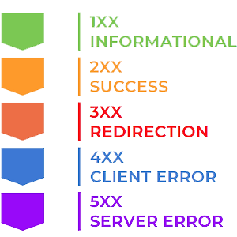
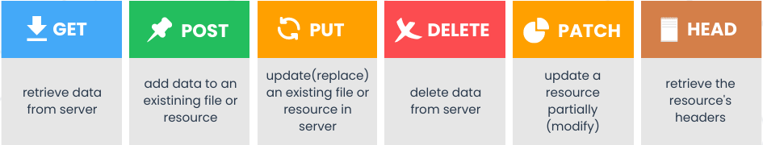
HTTP Status Codes
Key Concepts of RESTful APIs
Resources and URIs
Resources are represented by URIs.
For example, /users might represent a list of users
Data Format
JSON (JavaScript Object Notation) is commonly used for data exchange
HTTP Methods

Slide 6
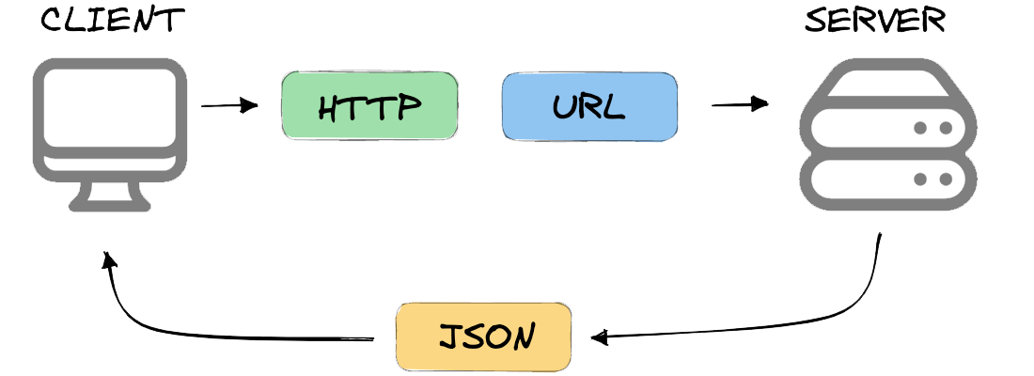
Why Use RESTful APIs?
Platform-independent
Can be used across different programming languages and platforms
Stateless Communication
Each request from client to server must contain all the information
needed to understand and process the request
Scalable
Easy to scale horizontally due to stateless nature
Easy to Cache
Responses can be cached to improve performance
Wide Adoption
RESTful APIs are widely supported and used in the industry

Slide 7
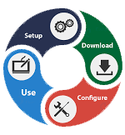
Setting up PHP Environment
PHP Installations
Ensure you have PHP 7.4 or later installed on your system
cURL Extension
cURL is a library that allows you to make HTTP requests. It should be
enabled in your PHP configuration (php.ini)
Composer
A dependency manager for PHP that makes it easier to manage project dependencies. Install it from getcomposer.org

Slide 8

Making HTTP Requests with cURL
Introduction
cURL is a powerful library for making HTTP requests in PHP
Basic Syntax
Initialize cURL session: curl_init()
Set options: curl_setopt()
Execute and fetch response: curl_exec()
Close cURL session: curl_close()

Slide 9

Authentication and Security
Common Authentication Methods
API Keys
Simple key-based authentication
OAuth
A more secure and flexible method for authentication and authorization
Securely Storing and Using API Keys
Store keys in environment variables or configuration files outside the web root
Never hard-code API keys in your source code
Handling Sensitive Data
Use HTTPS to encrypt data in transit
SSL/TLS
Ensure your server uses SSL/TLS for secure communication

Slide 10

Best Practices for Working with APIs
Rate Limiting and Retries
Respect API rate limits and implement retry logic for failed requests
Caching API Responses
Cache responses to reduce the number of API calls and improve performance
Keeping Code Modular and Reusable
Write reusable functions and classes for making API requests
Using PHP Libraries
Utilize libraries for more advanced and easy-to-use HTTP requests

Slide 11


Slide 12

What does API stand for?
Application Programming Interface
How APIs are useful in programming?
They provide precise data in less time
What HTTP status code indicates a successful API request?
200

